Slide 1

Hotel booking cancelation prediction

Slide 2
Problem statement. Data given in data set. Visualization. Step I have done. chosen model. conclusion.
CONTENT

Slide 3
ProBlem STaTEment
Type: Binary Classification Hotel booking cancelation prediction is classic problem to learn and apply lots of data analysis techniques to create best Classification model.
Given with the dataset consisting of details of applicants for hotel booking and status whether the booking application is approved or not. Basis on the a binary classification model is to be created with maximum accuracy.
The link of data set:"https://raw.githubusercontent.com/Premalatha-success/Datasets/main/hotel_bookings.csv"

Slide 4
Data given in data set
Dataset that we use in this problem is “hotel bookings”.
In this dataset there are vast number of observations and features/variables. Size of the dataset is 1,19,390*32. These are of different data types. Variables are classified

Slide 5
Data given in data set
object – hotel, arrival_date_month, meal,country, market_segment,distribution_channel, reserved_room_type,assigned_room_type , deposit_type, customer_type, reservation_status, reservation_status_date .
float – adr, agent, company, chidren
int - is_canceled, lead_time, arrival_date_year, babies, is_repeated_guest, previous_cancellations, previous_bookings_not_canceled, booking_changes, days_in_waiting_list, required_car_parking_spaces, total_of_special_requests.

Slide 6
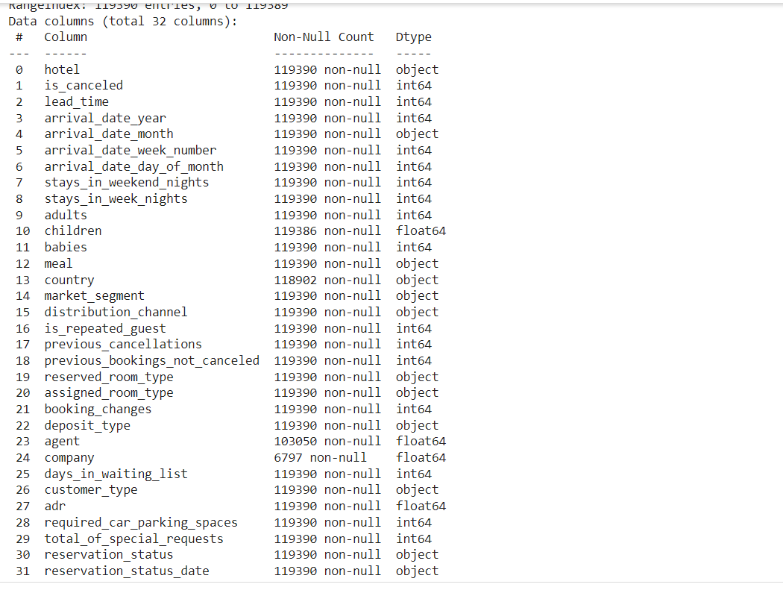
Data Types

Slide 7
Visualization
We may analyse data in greater depth by visualising it. Data may be shown in a variety of ways, including bar graphs, scatterplots, charting, pie charts, histograms, boxplots, and heatmaps. In this project, we visualise data using heatmaps, bar charts, and scatterplots to learn about various factors.

Slide 8
Visualization
Heat maps are used to locate missing values in a data collection. To put it another way, discover columns with null values. We can easily delete the columns with the most null values from this graph. It can also display confusion matrices and correlation matrices.
Scatter plots are useful for demonstrating the relationship between two variables.
Bar charts are used to illustrate the dependent variable in relation to the categorial data.

Slide 9
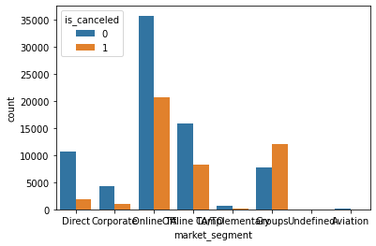
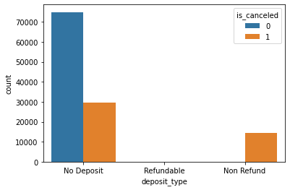
Feature to Feature BAR plot
Market segment and is_canceled
Deposit_type and is_canceled

Slide 10
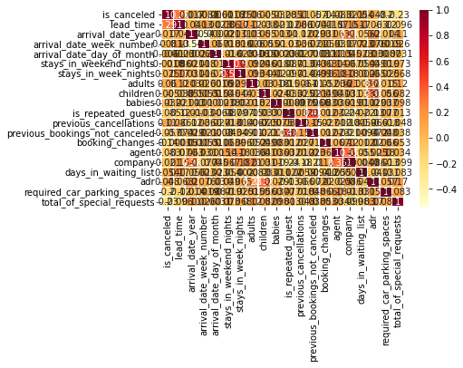
Heat map of Correlation

Slide 11
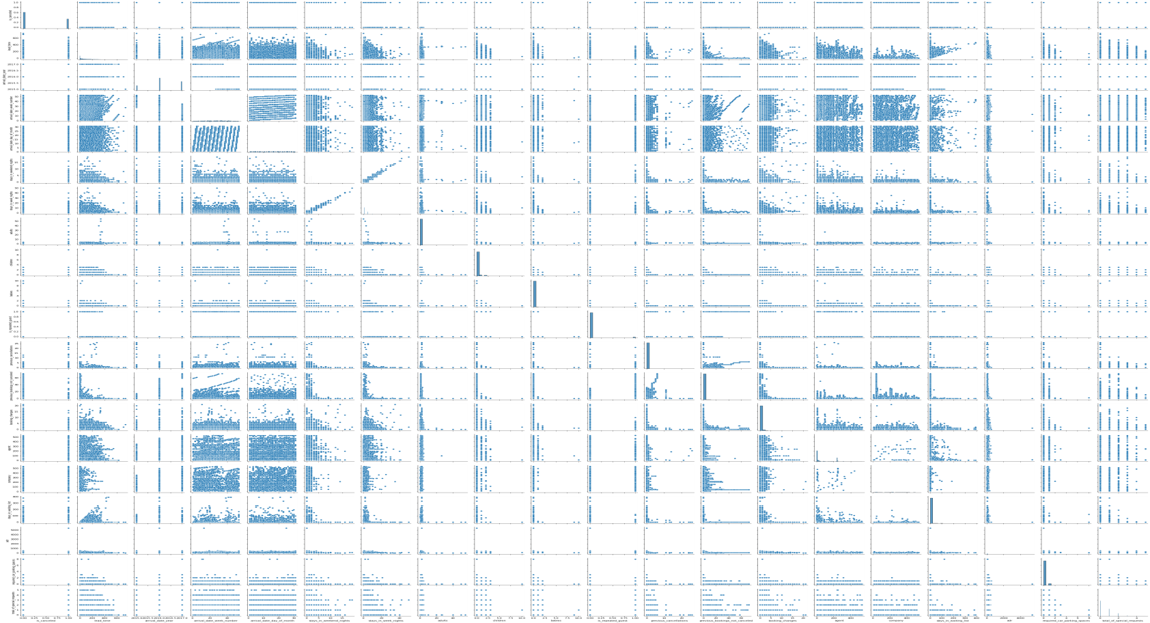
Pair plot
Pair plot between all the numerical data type variables. This graph helps us to understand the relation of a variable with all the other variables.

Slide 12
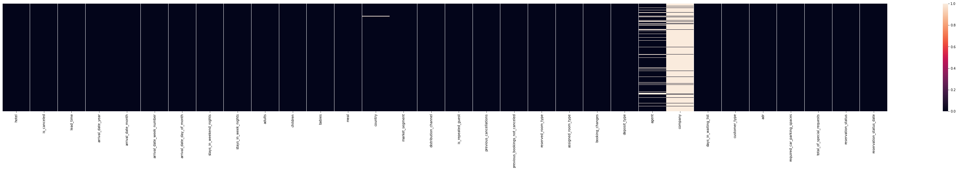
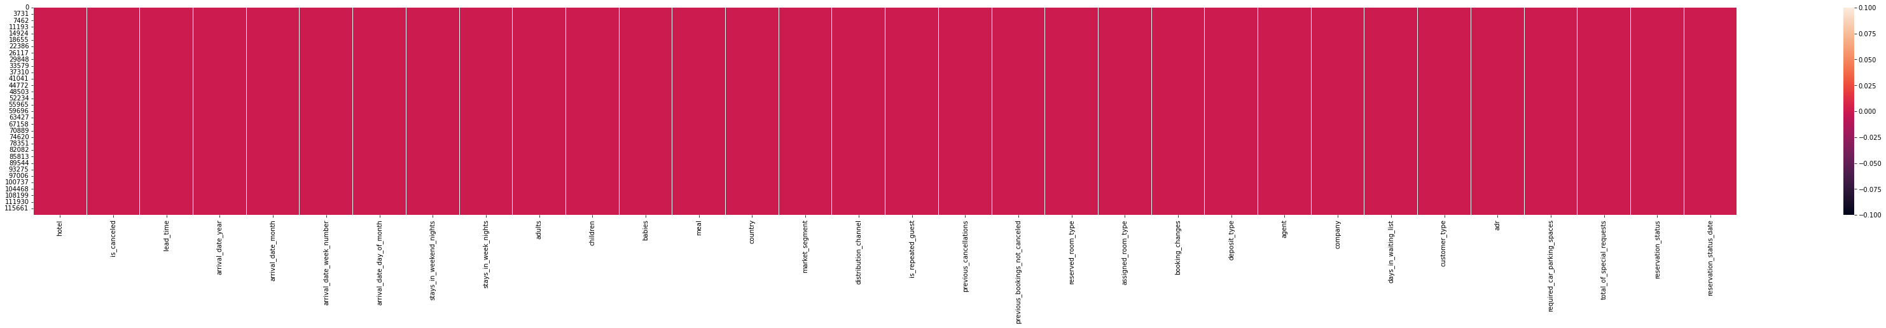
Visualization of null values
Null values before encoding
Null Values after encoding

Slide 13
Step I have done
Step 1: Importing Libraries.
Step 2: Analyzing Data.
STEP 3: Data Visualization.
STEP 4: Data Pre-processing.
Step 5: Encoding Categorial Data.
Steps 6: Splitting and Creating model.

Slide 14
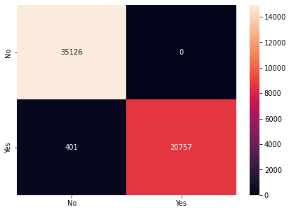
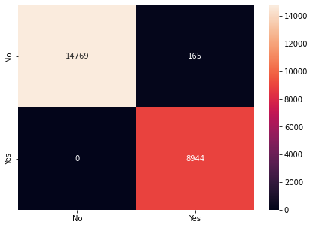
Confusion Matrices of Classifiers: Logistics regression and Navie bayes
Training:0.990053605829634
Testing:0.9892369545188039
Training:0.9929223553061396
Testing:0.9930898735237457

Slide 15
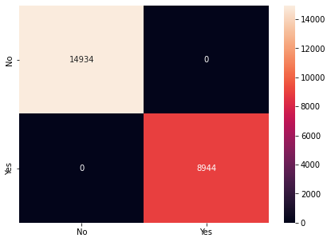
Confusion Matrices of Classifiers: Decision Tree
Training: 1.0
Testing: 1.0

Slide 16
Choosing Best Model:
In this project I had tried three classifiers. They are Logistics regression, navies bayes and decision Tree.
Among I will chose the decision tree because it shows 100% accuracy and it’s training and testing is equal one.

Slide 17
Conclusion:
I had employed three Machine Learning classification methods in this study to determine the cancellation status of hotel rooms using a given data set.
Following the visualization of features in the data set using training and testing data, we learn that the accuracy rate and precision of the three methods different values.
By seeing the confusion matrix of decision tree at Q1 and Q2 we values are equal zero.

Slide 18
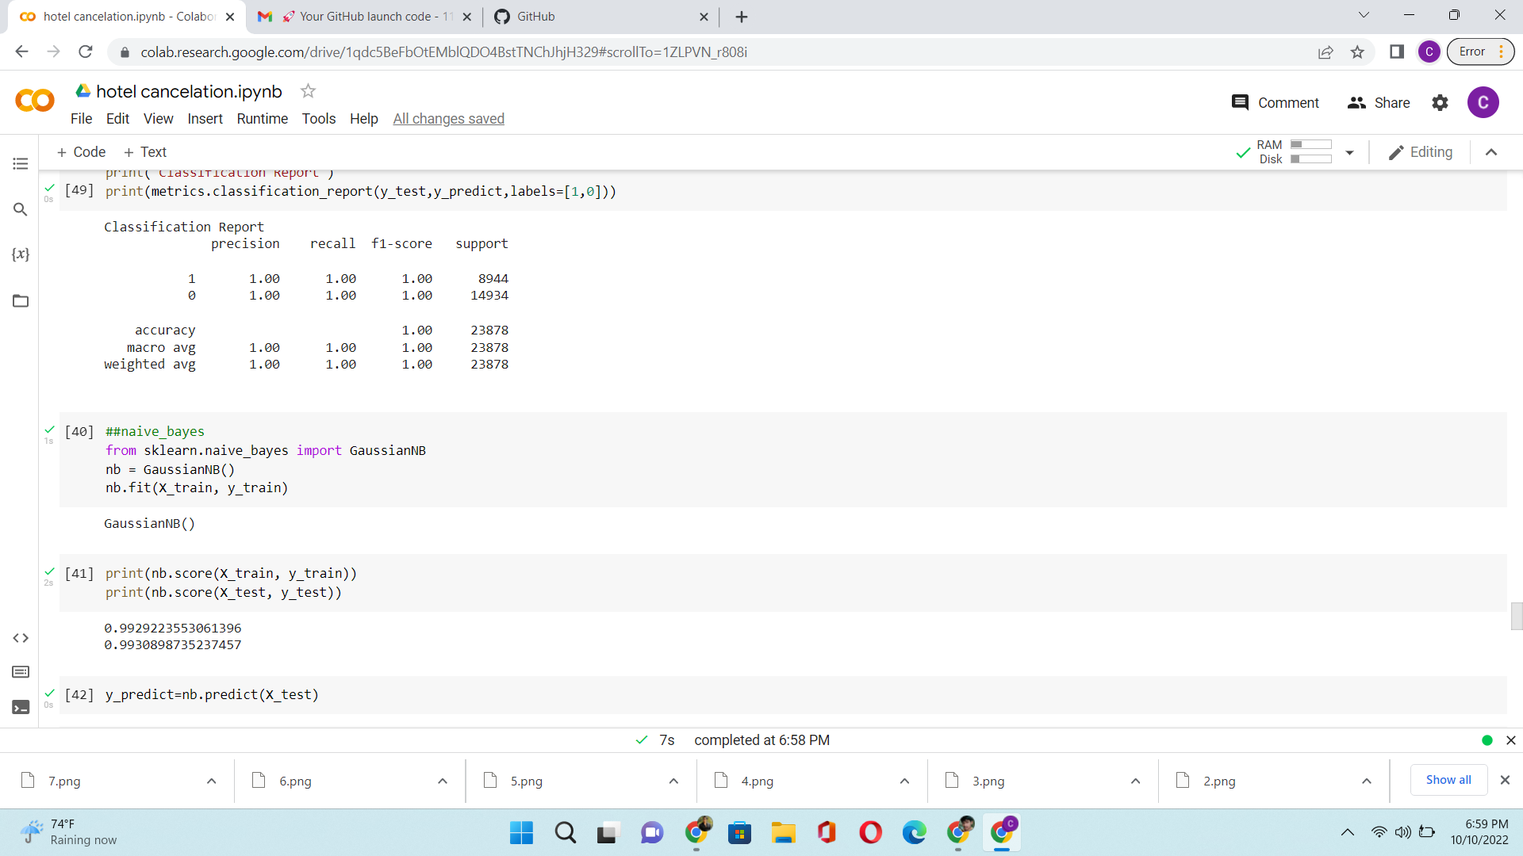
Conclusion: Classification report

Slide 19
Thank You
BY
CH.KOWSHIK
119CS0014

